Slide 1
Spelling Correction: Edit Distance
NPTEL
Pawan Goyal
CSE, IITKGP
Week 2: Lecture 1
Spelling Correction: Edit Distance
Week 2: Lecture 1

Slide 2
Spelling Correction
NPTEL
Spelling Correction: Edit Distance
Week 2: Lecture 1
2 / 20

Slide 3
Spelling Correction
I am writing this email on behaf of ...
NPTEL
Spelling Correction: Edit Distance
Week 2: Lecture 1
2 / 20

Slide 4
Spelling Correction
I am writing this email on behaf of ...
The user typed ‘behaf’.
Which are some close words?
NPTEL
Spelling Correction: Edit Distance
Week 2: Lecture 1
2 / 20

Slide 5
Spelling Correction
I am writing this email on behaf of ...
The user typed ‘behaf’.
Which are some close words?
behalf
behave
....
NPTEL
Spelling Correction: Edit Distance
Week 2: Lecture 1
2 / 20

Slide 6
Spelling Correction
I am writing this email on behaf of ...
The user typed ‘behaf’.
Which are some close words?
behalf
behave
....
Isolated word error correction
Pick the one that is closest to ‘behaf’
NPTEL
Spelling Correction: Edit Distance
Week 2: Lecture 1
2 / 20

Slide 7
Spelling Correction
I am writing this email on behaf of ...
The user typed ‘behaf’.
Which are some close words?
behalf
behave
....
Isolated word error correction
Pick the one that is closest to ‘behaf’
How to define ‘closest’?
NPTEL
Spelling Correction: Edit Distance
Week 2: Lecture 1
2 / 20

Slide 8
Spelling Correction
I am writing this email on behaf of ...
The user typed ‘behaf’.
Which are some close words?
behalf
behave
....
Isolated word error correction
Pick the one that is closest to ‘behaf’
How to define ‘closest’? Need a distance metric
NPTEL
Spelling Correction: Edit Distance
Week 2: Lecture 1
2 / 20

Slide 9
Spelling Correction
I am writing this email on behaf of ...
The user typed ‘behaf’.
Which are some close words?
behalf
behave
....
Isolated word error correction
Pick the one that is closest to ‘behaf’
How to define ‘closest’? Need a distance metric
The simplest metric: edit distance
NPTEL
Spelling Correction: Edit Distance
Week 2: Lecture 1
2 / 20

Slide 10
Edit Distance
The minimum edit distance between two strings
NPTEL
Spelling Correction: Edit Distance
Week 2: Lecture 1
3 / 20

Slide 11
Edit Distance
The minimum edit distance between two strings Is the minimum number of editing operations
NPTEL
Spelling Correction: Edit Distance
Week 2: Lecture 1
3 / 20

Slide 12
Edit Distance
The minimum edit distance between two strings Is the minimum number of editing operations
⁾ Insertion
⁾ Deletion
⁾ Substitution
NPTEL
Spelling Correction: Edit Distance
Week 2: Lecture 1
3 / 20

Slide 13
Minimum Edit Distance
Example
Edit distance from ‘intention’ to ‘execution’
NPTEL
Spelling Correction: Edit Distance
Week 2: Lecture 1
4 / 20

Slide 14

Minimum Edit Distance
Example
Edit distance from ‘intention’ to ‘execution’
NPTEL
Spelling Correction: Edit Distance
Week 2: Lecture 1
4 / 20

Slide 15
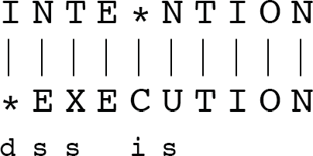
Minimum Edit Distance
NPTEL
Spelling Correction: Edit Distance
Week 2: Lecture 1
5 / 20

Slide 16
Minimum Edit Distance
NPTEL
If each operation has a cost of 1 (Levenshtein)
⁾ Distance between these is 5
Spelling Correction: Edit Distance
Week 2: Lecture 1
5 / 20

Slide 17
Minimum Edit Distance
NPTEL
If each operation has a cost of 1 (Levenshtein)
⁾ Distance between these is 5
If substitution costs 2 (alternate version)
⁾ Distance between these is 8
Spelling Correction: Edit Distance
Week 2: Lecture 1
5 / 20

Slide 18
How to find the Minimum Edit Distance?
NPTEL
Spelling Correction: Edit Distance
Week 2: Lecture 1
6 / 20

Slide 19
How to find the Minimum Edit Distance?
Searching for a path (sequence of edits) from the start string to the final string:
NPTEL
Spelling Correction: Edit Distance
Week 2: Lecture 1
6 / 20

Slide 20
How to find the Minimum Edit Distance?
Searching for a path (sequence of edits) from the start string to the final string:
Initial state: the word we are transforming
NPTEL
Spelling Correction: Edit Distance
Week 2: Lecture 1
6 / 20

Slide 21
How to find the Minimum Edit Distance?
Searching for a path (sequence of edits) from the start string to the final string:
Initial state: the word we are transforming
Operators: insert, delete, substitute
NPTEL
Spelling Correction: Edit Distance
Week 2: Lecture 1
6 / 20

Slide 22
How to find the Minimum Edit Distance?
Searching for a path (sequence of edits) from the start string to the final string:
Initial state: the word we are transforming
Operators: insert, delete, substitute
Goal state: the word we are trying to get to
NPTEL
Spelling Correction: Edit Distance
Week 2: Lecture 1
6 / 20

Slide 23
How to find the Minimum Edit Distance?
Searching for a path (sequence of edits) from the start string to the final string:
Initial state: the word we are transforming
Operators: insert, delete, substitute
Goal state: the word we are trying to get to
Path cost: what we want to minimize: the number of edits
NPTEL
Spelling Correction: Edit Distance
Week 2: Lecture 1
6 / 20

Slide 24
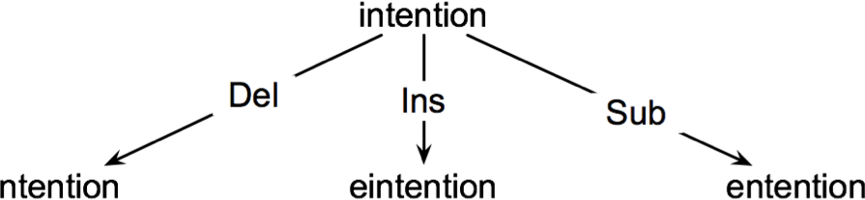
How to find the Minimum Edit Distance?
Searching for a path (sequence of edits) from the start string to the final string:
Initial state: the word we are transforming
Operators: insert, delete, substitute
Goal state: the word we are trying to get to
Path cost: what we want to minimize: the number of edits
NPTEL
Spelling Correction: Edit Distance
Week 2: Lecture 1
6 / 20

Slide 25
Minimum Edit as Search
How to navigate?
The space of all edit sequences is huge
NPTEL
Spelling Correction: Edit Distance
Week 2: Lecture 1
7 / 20

Slide 26
Minimum Edit as Search
How to navigate?
The space of all edit sequences is huge
Lot of distinct paths end up at the same state
NPTEL
Spelling Correction: Edit Distance
Week 2: Lecture 1
7 / 20

Slide 27
Minimum Edit as Search
How to navigate?
The space of all edit sequences is huge
Lot of distinct paths end up at the same state Don’t have to keep track of all of them
NPTEL
Spelling Correction: Edit Distance
Week 2: Lecture 1
7 / 20

Slide 28
Minimum Edit as Search
How to navigate?
The space of all edit sequences is huge
Lot of distinct paths end up at the same state Don’t have to keep track of all of them
Keep track of the shortest path to each state
NPTEL
Spelling Correction: Edit Distance
Week 2: Lecture 1
7 / 20

Slide 29
Defining Minimum Edit Distance Matrix
For two strings
X of length n Y of length m
NPTEL
Spelling Correction: Edit Distance
Week 2: Lecture 1
8 / 20

Slide 30
Defining Minimum Edit Distance Matrix
For two strings
X of length n Y of length m
We define D(i, j)
the edit distance between X[1..i] and Y[1..j]
i.e., the first i characters of X and the first j characters of Y
NPTEL
Spelling Correction: Edit Distance
Week 2: Lecture 1
8 / 20

Slide 31
Defining Minimum Edit Distance Matrix
For two strings
X of length n Y of length m
We define D(i, j)
the edit distance between X[1..i] and Y[1..j]
i.e., the first i characters of X and the first j characters of Y
Thus, the edit distance between X and Y is D(n, m)
NPTEL
Spelling Correction: Edit Distance
Week 2: Lecture 1
8 / 20

Slide 32
Computing Minimum Edit Distance
Dynamic Programming
A tabular computation of D(n, m)
NPTEL
Spelling Correction: Edit Distance
Week 2: Lecture 1
9 / 20

Slide 33
Computing Minimum Edit Distance
Dynamic Programming
A tabular computation of D(n, m)
Solving problems by combining solutions to subproblems
NPTEL
Spelling Correction: Edit Distance
Week 2: Lecture 1
9 / 20

Slide 34
Computing Minimum Edit Distance
Dynamic Programming
A tabular computation of D(n, m)
Solving problems by combining solutions to subproblems Bottom-up
NPTEL
Spelling Correction: Edit Distance
Week 2: Lecture 1
9 / 20

Slide 35
Computing Minimum Edit Distance
Dynamic Programming
A tabular computation of D(n, m)
Solving problems by combining solutions to subproblems Bottom-up
⁾ Compute D(i, j) for small i, j
NPTEL
Spelling Correction: Edit Distance
Week 2: Lecture 1
9 / 20

Slide 36
Computing Minimum Edit Distance
Dynamic Programming
A tabular computation of D(n, m)
Solving problems by combining solutions to subproblems Bottom-up
⁾ Compute D(i, j) for small i, j
⁾ Compute larger D(i, j) based on previously computed smaller values
NPTEL
Spelling Correction: Edit Distance
Week 2: Lecture 1
9 / 20

Slide 37
Computing Minimum Edit Distance
Dynamic Programming
A tabular computation of D(n, m)
Solving problems by combining solutions to subproblems Bottom-up
⁾ Compute D(i, j) for small i, j
⁾ Compute larger D(i, j) based on previously computed smaller values
⁾ Compute D(i, j) for all i and j till you get to D(n, m)
NPTEL
Spelling Correction: Edit Distance
Week 2: Lecture 1
9 / 20

Slide 38
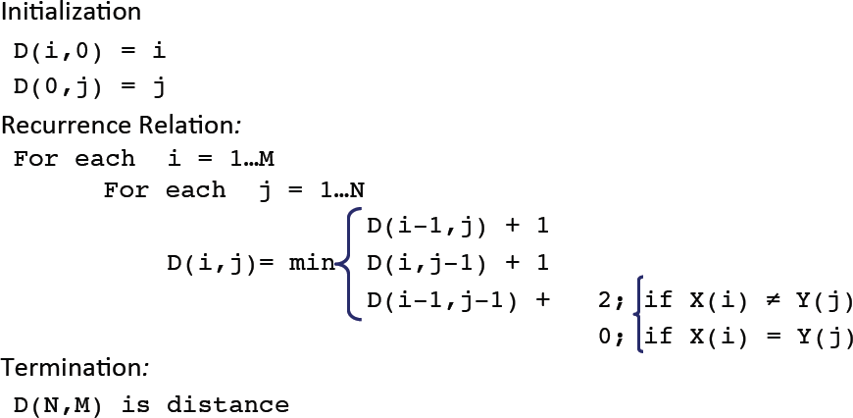
Dynamic Programming Algorithm
NPTEL
Spelling Correction: Edit Distance
Week 2: Lecture 1

Slide 39
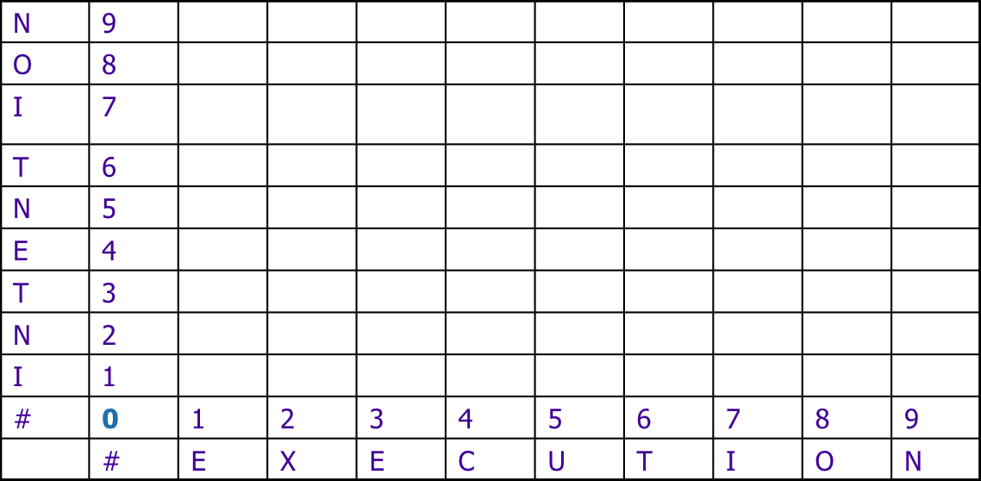
The Edit Distance Table
NPTEL
Spelling Correction: Edit Distance
Week 2: Lecture 1
11 / 20

Slide 40
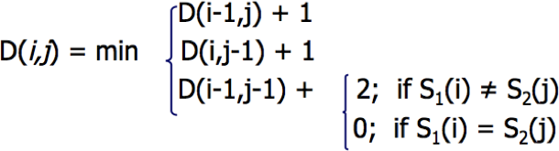
The Edit Distance Table
NPTEL
Spelling Correction: Edit Distance
Week 2: Lecture 1
11 / 20

Slide 41
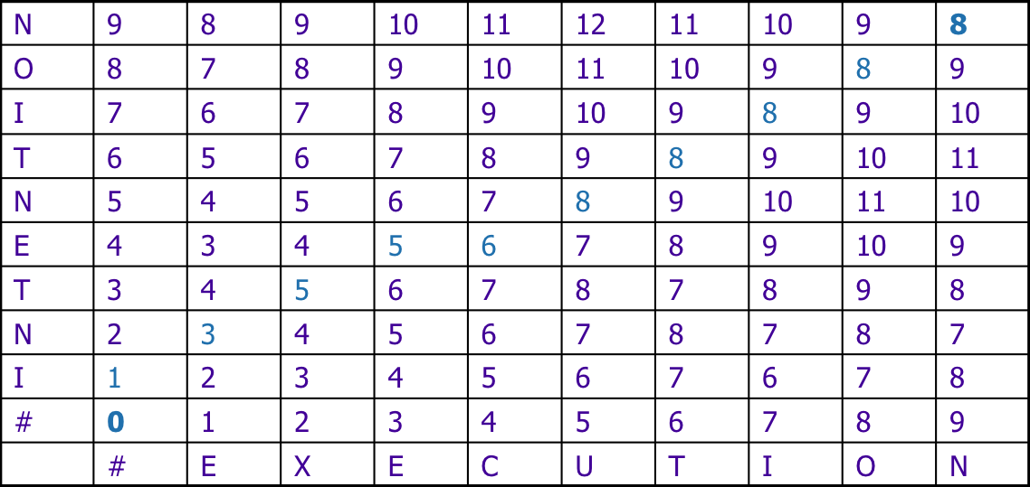
The Edit Distance Table
NPTEL
Spelling Correction: Edit Distance
Week 2: Lecture 1

Slide 42
Computing Alignments
NPTEL
Spelling Correction: Edit Distance
Week 2: Lecture 1
13 / 20

Slide 43
Computing edit distance may not be sufficient for some applications
Computing Alignments
NPTEL
Spelling Correction: Edit Distance
Week 2: Lecture 1
13 / 20

Slide 44
Computing Alignments
Computing edit distance may not be sufficient for some applications
⁾ We often need to align characters of the two strings to each other
NPTEL
Spelling Correction: Edit Distance
Week 2: Lecture 1
13 / 20

Slide 45
Computing Alignments
Computing edit distance may not be sufficient for some applications
⁾ We often need to align characters of the two strings to each other
We do this by keeping a “backtrace”
NPTEL
Spelling Correction: Edit Distance
Week 2: Lecture 1
13 / 20

Slide 46
Computing Alignments
Computing edit distance may not be sufficient for some applications
⁾ We often need to align characters of the two strings to each other
We do this by keeping a “backtrace”
Every time we enter a cell, remember where we came from
NPTEL
Spelling Correction: Edit Distance
Week 2: Lecture 1
13 / 20

Slide 47
Computing Alignments
Computing edit distance may not be sufficient for some applications
⁾ We often need to align characters of the two strings to each other
We do this by keeping a “backtrace”
Every time we enter a cell, remember where we came from When we reach the end,
NPTEL
Spelling Correction: Edit Distance
Week 2: Lecture 1
13 / 20

Slide 48
Computing Alignments
Computing edit distance may not be sufficient for some applications
⁾ We often need to align characters of the two strings to each other
We do this by keeping a “backtrace”
Every time we enter a cell, remember where we came from When we reach the end,
⁾ Trace back the path from the upper right corner to read off the alignment
NPTEL
Spelling Correction: Edit Distance
Week 2: Lecture 1
13 / 20

Slide 49
The Edit Distance Table
NPTEL
Spelling Correction: Edit Distance
Week 2: Lecture 1

Slide 50
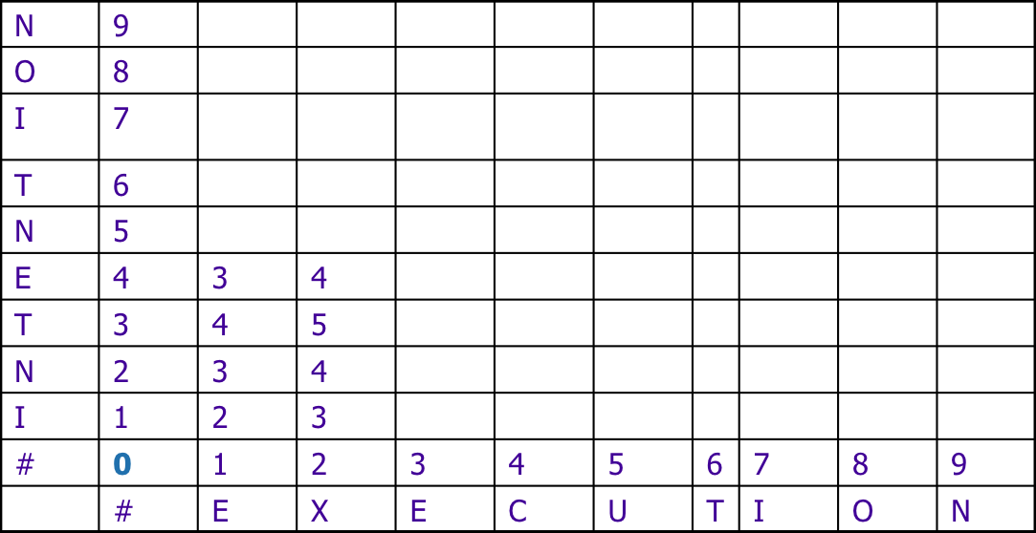
The Edit Distance Table
NPTEL
Spelling Correction: Edit Distance
Week 2: Lecture 1

Slide 51
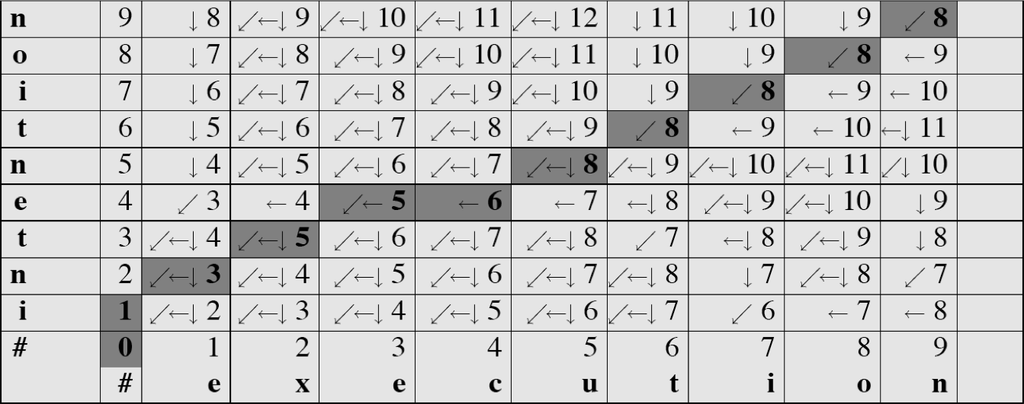
Minimum Edit with Backtrace
NPTEL
Spelling Correction: Edit Distance
Week 2: Lecture 1

Slide 52
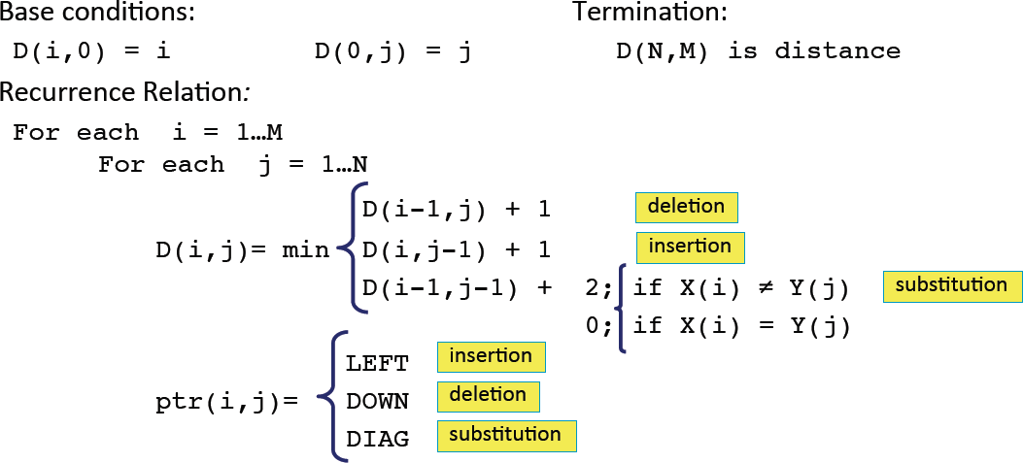
Adding Backtrace to Minimum Edit
NPTEL
Spelling Correction: Edit Distance
Week 2: Lecture 1

Slide 53
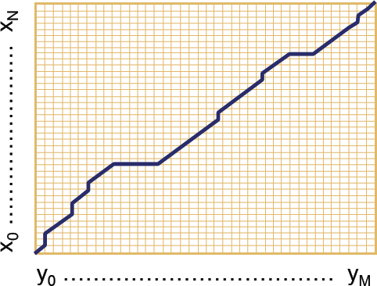
The distance matrix
NPTEL
Spelling Correction: Edit Distance
Week 2: Lecture 1
18 / 20

Slide 54
The distance matrix
Every non-decreasing path from (0,0) to (M,N) corresponds to an alignment of two sequences.
NPTEL
Spelling Correction: Edit Distance
Week 2: Lecture 1
18 / 20

Slide 55
The distance matrix
Every non-decreasing path from (0,0) to (M,N) corresponds to an alignment of two sequences.
An optimal alignment is composed of optimal sub-alignments.
NPTEL
Spelling Correction: Edit Distance
Week 2: Lecture 1
18 / 20

Slide 56
Result of Backtrace
NPTEL
Spelling Correction: Edit Distance
Week 2: Lecture 1

Slide 57
Performance
Time
NPTEL
Spelling Correction: Edit Distance
Week 2: Lecture 1
20 / 20

Slide 58
Time O(nm)
Performance
Space
NPTEL
Spelling Correction: Edit Distance
Week 2: Lecture 1
20 / 20

Slide 59
Performance
Time O(nm)
Space O(nm)
Backtrace
NPTEL
Spelling Correction: Edit Distance
Week 2: Lecture 1
20 / 20

Slide 60
Time O(nm)
Performance
Space O(nm)
Backtrace O(n + m)
NPTEL
Spelling Correction: Edit Distance
Week 2: Lecture 1
20 / 20

Slide 61
Weighted Edit Distance, Other variations
NPTEL
Pawan Goyal
CSE, IITKGP
Week 2: Lecture 2
Weighted Edit Distance, Other variations
Week 2: Lecture 2

Slide 62
Weighted Edit Distance
Why to add weights to the computation?
Some letters are more likely to be mistyped.
NPTEL
Weighted Edit Distance, Other variations
Week 2: Lecture 2

Slide 63
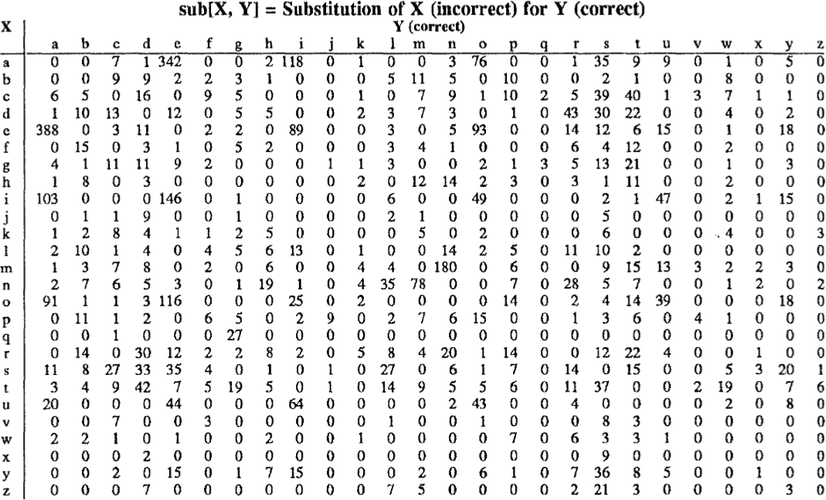
Confusion Matrix for Spelling Errors
NPTEL
Weighted Edit Distance, Other variations
Week 2: Lecture 2

Slide 64
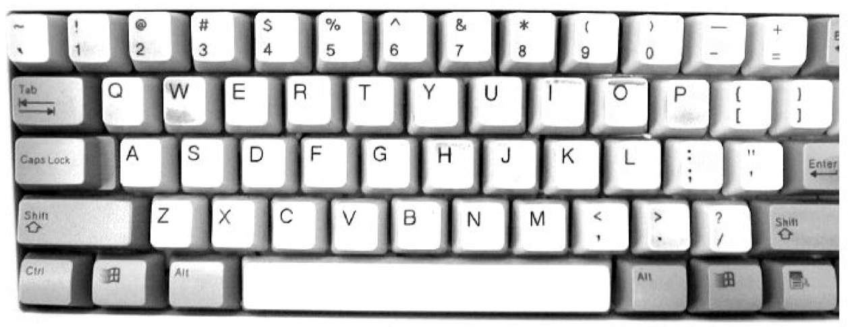
Keyboard Design
NPTEL
Weighted Edit Distance, Other variations
Week 2: Lecture 2

Slide 65
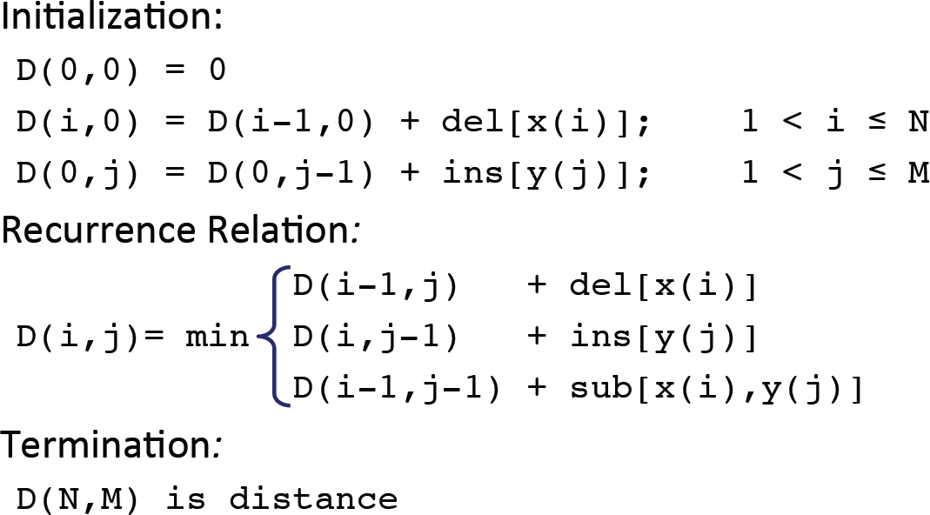
Weighted Minimum Edit Distance
NPTEL
Weighted Edit Distance, Other variations
Week 2: Lecture 2

Slide 66
How to modify the algorithm with transpose?
Transpose
transpose(x, y) = (y, x)
Also known as metathesis
NPTEL
Weighted Edit Distance, Other variations
Week 2: Lecture 2
6 / 12

Slide 67
How to modify the algorithm with transpose?
Transpose
transpose(x, y) = (y, x)
Also known as metathesis
Modification to the dynamic programmic algorithm
D(i − 1, j) + 1 (deletion)
NPTEL

D(i, j − 1) + 1 (insertion)

(

1 if (x[i] /= y[j])(substitution)
D[i][j] = min D(i − 1, j − 1)+
0 otherwise

D(i − 2, j − 2) + 1
(x[i] = y[j − 1] and x[i − 1] = y[j] (transposition)

Weighted Edit Distance, Other variations
Week 2: Lecture 2
6 / 12

Slide 68
How to find dictionary entries with smallest edit distance?
NPTEL
Weighted Edit Distance, Other variations
Week 2: Lecture 2
7 / 12

Slide 69
How to find dictionary entries with smallest edit distance?
Naïve Method
Compute edit ditance from the query term to each dictionary term – an exhaustive search
NPTEL
Weighted Edit Distance, Other variations
Week 2: Lecture 2
7 / 12

Slide 70
How to find dictionary entries with smallest edit distance?
Naïve Method
Compute edit ditance from the query term to each dictionary term – an exhaustive search
Can be made efficient if we do it over a trie structure
NPTEL
Weighted Edit Distance, Other variations
Week 2: Lecture 2
7 / 12

Slide 71
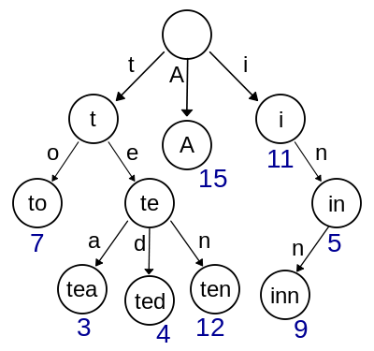
How to find dictionary entries with smallest edit distance?
Naïve Method
Compute edit ditance from the query term to each dictionary term – an exhaustive search
Can be made efficient if we do it over a trie structure
NPTEL
Weighted Edit Distance, Other variations
Week 2: Lecture 2
7 / 12

Slide 72
How to find dictionary entries with smallest edit distance?
NPTEL
Weighted Edit Distance, Other variations
Week 2: Lecture 2
8 / 12

Slide 73
How to find dictionary entries with smallest edit distance?
Generate all possible terms with an edit distance <=2 (deletion + transpose + substitution + insertion) from the query term and search them in the dictionary.
NPTEL
Weighted Edit Distance, Other variations
Week 2: Lecture 2
8 / 12

Slide 74
How to find dictionary entries with smallest edit distance?
Generate all possible terms with an edit distance <=2 (deletion + transpose + substitution + insertion) from the query term and search them in the dictionary.
For a word of length 9, alphabet of size 36, this will lead to 114,324 terms to search for
NPTEL
Weighted Edit Distance, Other variations
Week 2: Lecture 2
8 / 12

Slide 75
How to find dictionary entries with smallest edit distance?
Generate all possible terms with an edit distance <=2 (deletion + transpose + substitution + insertion) from the query term and search them in the dictionary.
For a word of length 9, alphabet of size 36, this will lead to 114,324 terms to search for
For Chinese alphabet size is 70,000 (Unicode Han Characters)
NPTEL
Weighted Edit Distance, Other variations
Week 2: Lecture 2
8 / 12

Slide 76
How to find dictionary entries with smallest edit distance?
Symmetric Delete Spelling Correction
Generate terms with an edit distance ≤ 2 (deletes) from each dictionary term (offline)
Generate terms with an edit distance ≤ 2 (deletes) from the input terms and search in dictionary
NPTEL
Weighted Edit Distance, Other variations
Week 2: Lecture 2
9 / 12

Slide 77
How to find dictionary entries with smallest edit distance?
Symmetric Delete Spelling Correction
Generate terms with an edit distance ≤ 2 (deletes) from each dictionary term (offline)
Generate terms with an edit distance ≤ 2 (deletes) from the input terms and search in dictionary
Number of deletes within edit distance ≤ 2 for a word of length 9 will be 45
NPTEL
Weighted Edit Distance, Other variations
Week 2: Lecture 2
9 / 12

Slide 78
How to find dictionary entries with smallest edit distance?
Symmetric Delete Spelling Correction
Generate terms with an edit distance ≤ 2 (deletes) from each dictionary term (offline)
Generate terms with an edit distance ≤ 2 (deletes) from the input terms and search in dictionary
Number of deletes within edit distance ≤ 2 for a word of length 9 will be 45
A further check is required to remove the false positives
NPTEL
Weighted Edit Distance, Other variations
Week 2: Lecture 2
9 / 12

Slide 79
Spelling Correction
NPTEL
Weighted Edit Distance, Other variations
Week 2: Lecture 2
10 / 12

Slide 80
Spelling Correction
Types of spelling errors: Non-word Errors
behaf → behalf
NPTEL
Weighted Edit Distance, Other variations
Week 2: Lecture 2
10 / 12

Slide 81
Spelling Correction
Types of spelling errors: Non-word Errors
behaf → behalf
Types of spelling errors: Real-word Errors
Typographical errors: three → there
Cognitive errors (homophones): piece → peace, too → two
NPTEL
Weighted Edit Distance, Other variations
Week 2: Lecture 2
10 / 12

Slide 82
Non-word spelling errors
Non-word spelling error detection
Any word not in a dictionary is an error The larger the dictionary the better
NPTEL
Weighted Edit Distance, Other variations
Week 2: Lecture 2
11 / 12

Slide 83
Non-word spelling errors
Non-word spelling error detection
Any word not in a dictionary is an error The larger the dictionary the better
Non-word spelling error correction
Generate candidates: real words that are similar to the error word Choose the best one:
⁾ Shortest weighted edit distance
⁾ Highest noisy channel probabliity
NPTEL
Weighted Edit Distance, Other variations
Week 2: Lecture 2
11 / 12

Slide 84
Real word spelling errors
For each word w, generate candidate set
Find candidate words with similar pronunciations Find candidate words with similar spelling Include w in candidate set
NPTEL
Weighted Edit Distance, Other variations
Week 2: Lecture 2
12 / 12

Slide 85
Real word spelling errors
For each word w, generate candidate set
Find candidate words with similar pronunciations Find candidate words with similar spelling Include w in candidate set
Choosing best candidate
Noisy Channel
NPTEL
Weighted Edit Distance, Other variations
Week 2: Lecture 2
12 / 12

Slide 86
Noisy Channel Model for Spelling Correction
NPTEL
Pawan Goyal
CSE, IITKGP
Week 2: Lecture 3
Noisy Channel Model for Spelling Correction
Week 2: Lecture 3

Slide 87
Noisy Channel
We see an observation x of the misspelled word
Find the correct word w
wˆ = argmaxP(w|x)
w∈V
NPTEL
Noisy Channel Model for Spelling Correction
Week 2: Lecture 3
2 / 17

Slide 88
Noisy Channel
We see an observation x of the misspelled word
Find the correct word w
wˆ = argmaxP(w|x)
w∈V
NPTEL
P(x|w)P(w)
= argmax
w∈V
P(x)
Noisy Channel Model for Spelling Correction
Week 2: Lecture 3
2 / 17

Slide 89
Noisy Channel
We see an observation x of the misspelled word
Find the correct word w
wˆ = argmaxP(w|x)
w∈V
NPTEL
P(x|w)P(w)
= argmax
w∈V
P(x)
= argmaxP(x|w)P(w)
w∈V
Noisy Channel Model for Spelling Correction
Week 2: Lecture 3
2 / 17

Slide 90
Non-word spelling error: acress
Words with similar spelling
Small edit distance to error
Words with similar pronuncitation
Small edit distance of pronunciation to error
NPTEL
Noisy Channel Model for Spelling Correction
Week 2: Lecture 3
3 / 17

Slide 91
Non-word spelling error: acress
Words with similar spelling
Small edit distance to error
Words with similar pronuncitation
Small edit distance of pronunciation to error
Damerau-Levenshtein edit distance
Minimum edit distance, where edits are:
NPTEL
Noisy Channel Model for Spelling Correction
Week 2: Lecture 3
3 / 17

Slide 92
Non-word spelling error: acress
Words with similar spelling
Small edit distance to error
Words with similar pronuncitation
Small edit distance of pronunciation to error
Damerau-Levenshtein edit distance Minimum edit distance, where edits are: Insertion, Deletion, Substitution,
NPTEL
Noisy Channel Model for Spelling Correction
Week 2: Lecture 3
3 / 17

Slide 93
Non-word spelling error: acress
Words with similar spelling
Small edit distance to error
Words with similar pronuncitation
Small edit distance of pronunciation to error
Damerau-Levenshtein edit distance Minimum edit distance, where edits are: Insertion, Deletion, Substitution, Transposition of two adjacent letters
NPTEL
Noisy Channel Model for Spelling Correction
Week 2: Lecture 3
3 / 17

Slide 94
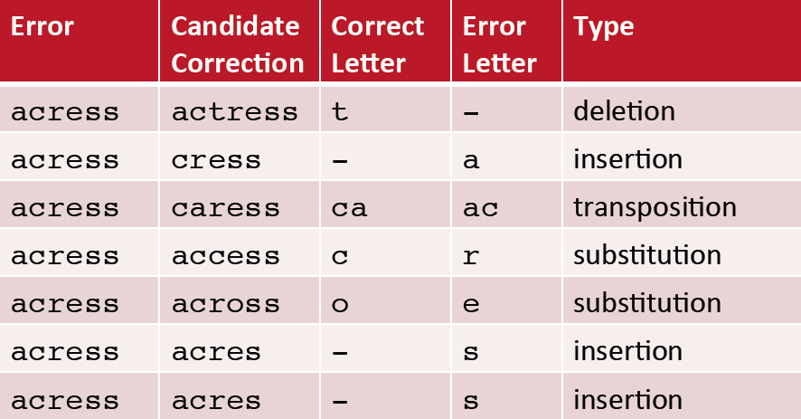
Words within edit distance 1 of acress
NPTEL
Noisy Channel Model for Spelling Correction
Week 2: Lecture 3

Slide 95
Candidate generation
80% of errors are within edit distance 1 Almost all errors within edit distance 2
NPTEL
Noisy Channel Model for Spelling Correction
Week 2: Lecture 3
5 / 17

Slide 96
Candidate generation
80% of errors are within edit distance 1 Almost all errors within edit distance 2
Allow deletion of space or hyphen
thisidea → this idea inlaw → in-law
NPTEL
Noisy Channel Model for Spelling Correction
Week 2: Lecture 3
5 / 17

Slide 97
Computing error probability: confusion matrix
del[x,y]: count (xy typed as x) ins[x,y]: count (x typed as xy) sub[x,y]: count (x typed as y) trans[x,y]: count(xy typed as yx)
NPTEL
Noisy Channel Model for Spelling Correction
Week 2: Lecture 3
6 / 17

Slide 98
Computing error probability: confusion matrix
del[x,y]: count (xy typed as x) ins[x,y]: count (x typed as xy) sub[x,y]: count (x typed as y) trans[x,y]: count(xy typed as yx)
Insertion and deletion are conditioned on previous character
NPTEL
Noisy Channel Model for Spelling Correction
Week 2: Lecture 3
6 / 17

Slide 99
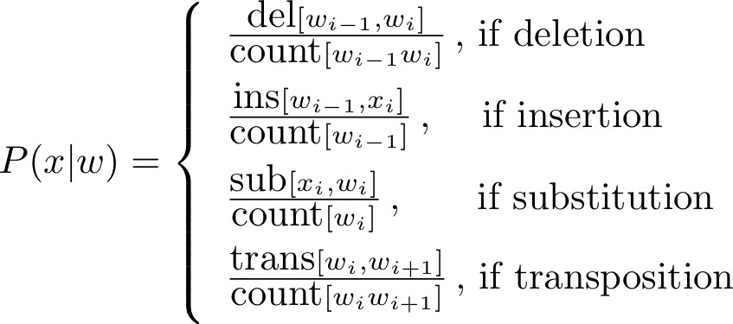
Channel model
NPTEL
Noisy Channel Model for Spelling Correction
Week 2: Lecture 3

Slide 100
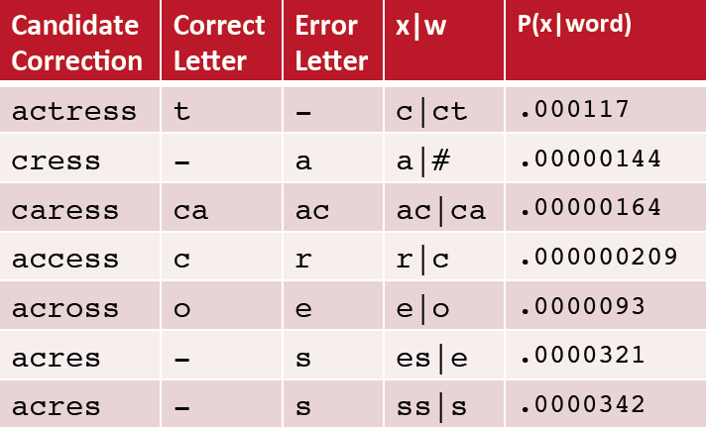
Channel model for acress
NPTEL
Noisy Channel Model for Spelling Correction
Week 2: Lecture 3

Slide 101
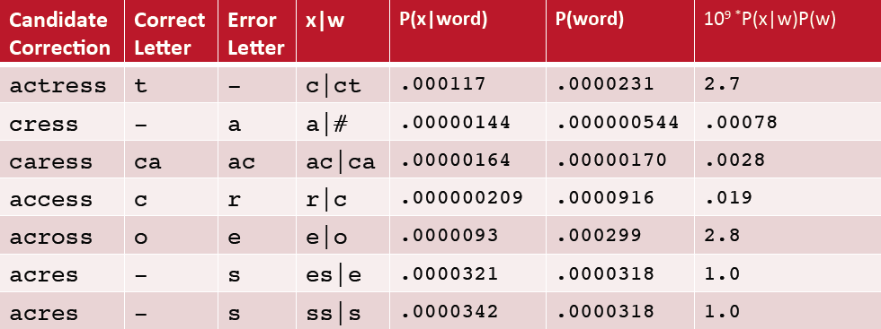
Noisy channel probability for acress
NPTEL
Noisy Channel Model for Spelling Correction
Week 2: Lecture 3

Slide 102
Using a bigram language model
“ ... versatile acress whose ...”
NPTEL
Noisy Channel Model for Spelling Correction
Week 2: Lecture 3
10 / 17

Slide 103
Using a bigram language model
“ ... versatile acress whose ...”
Counts from the Corpus of Contemporary American English with add-1 smoothing
NPTEL
Noisy Channel Model for Spelling Correction
Week 2: Lecture 3
10 / 17

Slide 104
Using a bigram language model
“ ... versatile acress whose ...”
Counts from the Corpus of Contemporary American English with add-1 smoothing
P(actress|versatile) = 0.000021, P(across|versatile) = 0.000021
NPTEL
Noisy Channel Model for Spelling Correction
Week 2: Lecture 3
10 / 17

Slide 105
Using a bigram language model
“ ... versatile acress whose ...”
Counts from the Corpus of Contemporary American English with add-1 smoothing
P(actress|versatile) = 0.000021, P(across|versatile) = 0.000021
P(whose|actress) = 0.0010, P(whose|across) = 0.000006
NPTEL
Noisy Channel Model for Spelling Correction
Week 2: Lecture 3
10 / 17

Slide 106
Using a bigram language model
“ ... versatile acress whose ...”
Counts from the Corpus of Contemporary American English with add-1 smoothing
P(actress|versatile) = 0.000021, P(across|versatile) = 0.000021
P(whose|actress) = 0.0010, P(whose|across) = 0.000006 P(“versatile actress whose”) = 0.000021 * 0.0010 = 210 x 10⁻¹⁰
NPTEL
Noisy Channel Model for Spelling Correction
Week 2: Lecture 3
10 / 17

Slide 107
Using a bigram language model
“ ... versatile acress whose ...”
Counts from the Corpus of Contemporary American English with add-1 smoothing
P(actress|versatile) = 0.000021, P(across|versatile) = 0.000021
P(whose|actress) = 0.0010, P(whose|across) = 0.000006 P(“versatile actress whose”) = 0.000021 * 0.0010 = 210 x 10⁻¹⁰ P(“versatile across whose”) = 0.000021 * 0.000006 = 1 x10⁻¹⁰
NPTEL
Noisy Channel Model for Spelling Correction
Week 2: Lecture 3
10 / 17

Slide 108
Real-word spelling errors
The study was conducted mainly be John Black The design an construction of the system ...
NPTEL
Noisy Channel Model for Spelling Correction
Week 2: Lecture 3
11 / 17

Slide 109
Real-word spelling errors
The study was conducted mainly be John Black The design an construction of the system ...
25-40% of spelling errors are real words
NPTEL
Noisy Channel Model for Spelling Correction
Week 2: Lecture 3
11 / 17

Slide 110
Noisy channel for real-word spell correction
Given a sentence X = w₁, w₂, w₃ . . . , w_{n} Candidate (w₁) = {w₁, w′₁, w′′₁, w′′′₁, . . .} Candidate (w₂) = {w₂, w′₂, w′′₂, w′′′₂, . . .} Candidate (w₃) = {w₃, w′₃, w′′₃, w′′′₃, . . .}
NPTEL
Noisy Channel Model for Spelling Correction
Week 2: Lecture 3
12 / 17

Slide 111
Noisy channel for real-word spell correction
Given a sentence X = w₁, w₂, w₃ . . . , w_{n} Candidate (w₁) = {w₁, w′₁, w′′₁, w′′′₁, . . .} Candidate (w₂) = {w₂, w′₂, w′′₂, w′′′₂, . . .} Candidate (w₃) = {w₃, w′₃, w′′₃, w′′′₃, . . .}
Choose the sequence W that maximizes P(W|X)
NPTEL
Noisy Channel Model for Spelling Correction
Week 2: Lecture 3
12 / 17

Slide 112
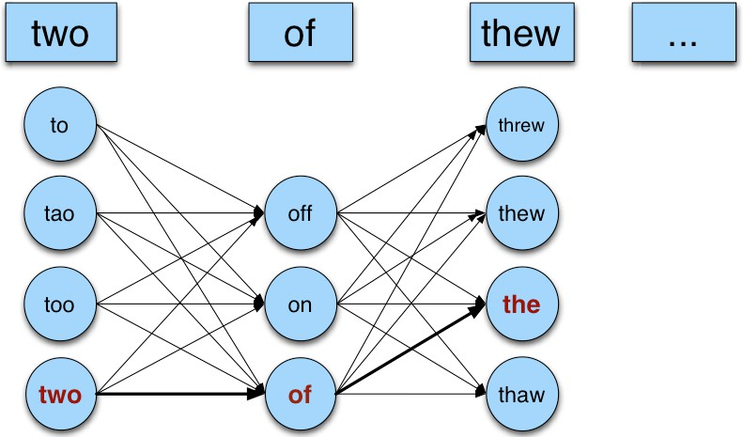
Noisy channel for real-world spell correction
NPTEL
Noisy Channel Model for Spelling Correction
Week 2: Lecture 3

Slide 113
Simplification: One error per sentence
Choose among all possible sentences with one word replaced
two of thew
w₁, w′′₂, w₃ two off thew w₁, w₂, w′₃ two of the w′′′₁, w₂, w₃ too of thew
NPTEL
Noisy Channel Model for Spelling Correction
Week 2: Lecture 3
14 / 17

Slide 114
Simplification: One error per sentence
Choose among all possible sentences with one word replaced
two of thew
w₁, w′′₂, w₃ two off thew w₁, w₂, w′₃ two of the w′′′₁, w₂, w₃ too of thew
Choose the sequence W that maximizes P(W|X)
NPTEL
Noisy Channel Model for Spelling Correction
Week 2: Lecture 3
14 / 17

Slide 115
Getting the probability values
Noisy Channel
W^{ˆ} = argmaxP(W|X)
W∈S
where X is the observed sentence and S is the set of all the possible sequences from the candidate set
NPTEL
Noisy Channel Model for Spelling Correction
Week 2: Lecture 3
15 / 17

Slide 116
Getting the probability values
Noisy Channel
W^{ˆ} = argmaxP(W|X)
W∈S
where X is the observed sentence and S is the set of all the possible sequences from the candidate set
= argmaxP(X|W)P(W)
W∈S
NPTEL
Noisy Channel Model for Spelling Correction
Week 2: Lecture 3
15 / 17

Slide 117
Getting the probability values
Noisy Channel
W^{ˆ} = argmaxP(W|X)
W∈S
where X is the observed sentence and S is the set of all the possible sequences from the candidate set
= argmaxP(X|W)P(W)
W∈S
P(X|W)
Same as for non-word spelling correction
NPTEL
Noisy Channel Model for Spelling Correction
Week 2: Lecture 3
15 / 17

Slide 118
Getting the probability values
Noisy Channel
W^{ˆ} = argmaxP(W|X)
W∈S
where X is the observed sentence and S is the set of all the possible sequences from the candidate set
= argmaxP(X|W)P(W)
W∈S
P(X|W)
Same as for non-word spelling correction Also require proabability for no error P(w|w)
NPTEL
Noisy Channel Model for Spelling Correction
Week 2: Lecture 3
15 / 17

Slide 119
What is the probability for a correctly typed word? P(“the”|“the”)
Probability of no error
NPTEL
Noisy Channel Model for Spelling Correction
Week 2: Lecture 3
16 / 17

Slide 120
Probability of no error
What is the probability for a correctly typed word? P(“the”|“the”)
It may depend on the source text under consideration
1 error in 10 words → 0.9
1 error in 100 words → 0.99
NPTEL
Noisy Channel Model for Spelling Correction
Week 2: Lecture 3
16 / 17

Slide 121
Computing P(W)
Use Language Model
Unigram Bigram
...
NPTEL
Noisy Channel Model for Spelling Correction
Week 2: Lecture 3
17 / 17

Slide 122
N-gram Language Models
NPTEL
Pawan Goyal
CSE, IITKGP
Week 2: Lecture 4
N-gram Language Models
Week 2: Lecture 4

Slide 123
Context Sensitive Spelling Correction
NPTEL
N-gram Language Models
Week 2: Lecture 4
2 / 24

Slide 124
Context Sensitive Spelling Correction
The office is about fifteen minuets from my house
NPTEL
N-gram Language Models
Week 2: Lecture 4
2 / 24

Slide 125
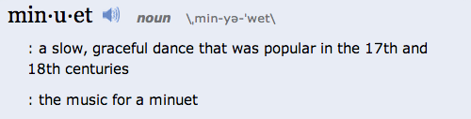
Context Sensitive Spelling Correction
The office is about fifteen minuets from my house
NPTEL
N-gram Language Models
Week 2: Lecture 4
2 / 24

Slide 126
Context Sensitive Spelling Correction
The office is about fifteen minuets from my house
NPTEL
Use a Language Model
P(about fifteen minutes from) > P(about fifteen minuets from)
N-gram Language Models
Week 2: Lecture 4
2 / 24

Slide 127
Probablilistic Language Models: Applications
Speech Recognition
P(I saw a van) >> P(eyes awe of an)
NPTEL
N-gram Language Models
Week 2: Lecture 4
3 / 24

Slide 128
Probablilistic Language Models: Applications
Speech Recognition
P(I saw a van) >> P(eyes awe of an)
Machine Translation
Which sentence is more plausible in the target language?
P(high winds) > P(large winds)
NPTEL
N-gram Language Models
Week 2: Lecture 4
3 / 24

Slide 129
Probablilistic Language Models: Applications
Speech Recognition
P(I saw a van) >> P(eyes awe of an)
Machine Translation
Which sentence is more plausible in the target language?
P(high winds) > P(large winds)
Other Applications
Context Sensitive Spelling Correction Natural Language Generation
...
NPTEL
N-gram Language Models
Week 2: Lecture 4
3 / 24

Slide 130
Completion Prediction
Language model also supports predicting the completion of a sentence.
⁾ Please turn off your cell ...
⁾ Your program does not ...
NPTEL
N-gram Language Models
Week 2: Lecture 4
4 / 24

Slide 131
Completion Prediction
Language model also supports predicting the completion of a sentence.
⁾ Please turn off your cell ...
⁾ Your program does not ...
Predictive text input systems can guess what you are typing and give choices on how to complete it.
NPTEL
N-gram Language Models
Week 2: Lecture 4
4 / 24

Slide 132
Probabilistic Language Modeling
Goal: Compute the probability of a sentence or sequence of words:
P(W) = P(w₁, w₂, w₃,..., w_{n})
NPTEL
N-gram Language Models
Week 2: Lecture 4
5 / 24

Slide 133
Probabilistic Language Modeling
Goal: Compute the probability of a sentence or sequence of words:
P(W) = P(w₁, w₂, w₃,..., w_{n})
Related Task: probability of an upcoming word:
P(w₄|w₁, w₂, w₃)
NPTEL
N-gram Language Models
Week 2: Lecture 4
5 / 24

Slide 134
Probabilistic Language Modeling
Goal: Compute the probability of a sentence or sequence of words:
P(W) = P(w₁, w₂, w₃,..., w_{n})
Related Task: probability of an upcoming word:
P(w₄|w₁, w₂, w₃)
A model that computes either of these is called a language model
NPTEL
N-gram Language Models
Week 2: Lecture 4
5 / 24

Slide 135
Computing P(W)
How to compute the joint probability
P(about, fifteen, minutes, from)
NPTEL
N-gram Language Models
Week 2: Lecture 4
6 / 24

Slide 136
Computing P(W)
How to compute the joint probability
P(about, fifteen, minutes, from)
Basic Idea
Rely on the Chain Rule of Probability
NPTEL
N-gram Language Models
Week 2: Lecture 4
6 / 24

Slide 137
The Chain Rule
Conditional Probabilities
P(B|A) = ^{P(A, B)}
P(A)
NPTEL
N-gram Language Models
Week 2: Lecture 4
7 / 24

Slide 138
The Chain Rule
Conditional Probabilities
P(B|A) = ^{P(A, B)}
P(A)
P(A, B) = P(A)P(B|A)
NPTEL
N-gram Language Models
Week 2: Lecture 4
7 / 24

Slide 139
The Chain Rule
Conditional Probabilities
P(B|A) = ^{P(A, B)}
P(A)
P(A, B) = P(A)P(B|A)
More Variables
P(A, B, C, D) = P(A)P(B|A)P(C|A, B)P(D|A, B, C)
NPTEL
N-gram Language Models
Week 2: Lecture 4
7 / 24

Slide 140
The Chain Rule
Conditional Probabilities
P(B|A) = ^{P(A, B)}
P(A)
P(A, B) = P(A)P(B|A)
More Variables
P(A, B, C, D) = P(A)P(B|A)P(C|A, B)P(D|A, B, C)
The Chain Rule in General
P(x₁, x₂, . . . , x_{n}) = P(x₁)P(x₂|x₁)P(x₃|x₁, x₂) . . . P(x_{n}|x₁,..., x_{n−1})
NPTEL
N-gram Language Models
Week 2: Lecture 4
7 / 24

Slide 141
Probability of words in sentences
P(w₁w₂ . . . w_{n}) = ∏P(w_{i}|w₁w₂ . . . w_{i−1})
i
P(“about fifteen minutes from”) =
NPTEL
N-gram Language Models
Week 2: Lecture 4
8 / 24

Slide 142
Probability of words in sentences
P(w₁w₂ . . . w_{n}) = ∏P(w_{i}|w₁w₂ . . . w_{i−1})
i
P(“about fifteen minutes from”) =
P(about) x P(fifteen | about) x P(minutes | about fifteen) x P(from | about fifteen minutes)
NPTEL
N-gram Language Models
Week 2: Lecture 4
8 / 24

Slide 143
Estimating These Probability Values
Count and divide
P(office | about fifteen minutes from) = Count (about fifteen minutes from office)
Count (about fifteen minutes from)
NPTEL
N-gram Language Models
Week 2: Lecture 4
9 / 24

Slide 144
Estimating These Probability Values
Count and divide
P(office | about fifteen minutes from) = Count (about fifteen minutes from office)
Count (about fifteen minutes from)
What is the problem
We may never see enough data for estimating these
NPTEL
N-gram Language Models
Week 2: Lecture 4
9 / 24

Slide 145
Markov Assumption
Simplifying Assumption: Use only the previous word
P(office | about fifteen minutes from) ≈ P(office | from)
NPTEL
N-gram Language Models
Week 2: Lecture 4
10 / 24

Slide 146
Markov Assumption
Simplifying Assumption: Use only the previous word
P(office | about fifteen minutes from) ≈ P(office | from)
Or the couple previous words
P(office | about fifteen minutes from) ≈ P(office | minutes from)
NPTEL
N-gram Language Models
Week 2: Lecture 4
10 / 24

Slide 147
Markov Assumption
More Formally: kth order Markov Model
Chain Rule:
P(w₁w₂ . . . w_{n}) = ∏P(w_{i}|w₁w₂ . . . w_{i−1})
i
NPTEL
N-gram Language Models
Week 2: Lecture 4
11 / 24

Slide 148
Markov Assumption
More Formally: kth order Markov Model
Chain Rule:
P(w₁w₂ . . . w_{n}) = ∏P(w_{i}|w₁w₂ . . . w_{i−1})
i
Using Markov Assumption: only k previous words
P(w₁w₂ . . . w_{n}) ≈ ∏P(w_{i}|w_{i−k} . . . w_{i−1})
i
NPTEL
N-gram Language Models
Week 2: Lecture 4
11 / 24

Slide 149
Markov Assumption
More Formally: kth order Markov Model
Chain Rule:
P(w₁w₂ . . . w_{n}) = ∏P(w_{i}|w₁w₂ . . . w_{i−1})
i
Using Markov Assumption: only k previous words
P(w₁w₂ . . . w_{n}) ≈ ∏P(w_{i}|w_{i−k} . . . w_{i−1})
i
We approximate each component in the product
NPTEL
P(w_{i}|w₁w₂ . . . w_{i−1}) ≈ P(w_{i}|w_{i−k} . . . w_{i−1})
N-gram Language Models
Week 2: Lecture 4
11 / 24

Slide 150
N-Gram Models
P(office | about fifteen minutes from)
An N-gram model uses only N − 1 words of prior context.
NPTEL
N-gram Language Models
Week 2: Lecture 4
12 / 24

Slide 151
N-Gram Models
P(office | about fifteen minutes from)
An N-gram model uses only N − 1 words of prior context.
Unigram: P(office) Bigram: P(office | from)
Trigram: P(office | minutes from)
NPTEL
N-gram Language Models
Week 2: Lecture 4
12 / 24

Slide 152
N-Gram Models
P(office | about fifteen minutes from)
An N-gram model uses only N − 1 words of prior context.
Unigram: P(office) Bigram: P(office | from)
Trigram: P(office | minutes from)
Markov model and Language Model
NPTEL
N-gram Language Models
Week 2: Lecture 4
12 / 24

Slide 153
N-Gram Models
P(office | about fifteen minutes from)
An N-gram model uses only N − 1 words of prior context.
Unigram: P(office) Bigram: P(office | from)
Trigram: P(office | minutes from)
Markov model and Language Model
An N-gram model is an N − 1-order Markov Model
NPTEL
N-gram Language Models
Week 2: Lecture 4
12 / 24

Slide 154
N-Gram Models
We can extend to trigrams, 4-grams, 5-grams In general, an insufficient model of language:
NPTEL
N-gram Language Models
Week 2: Lecture 4
13 / 24

Slide 155
N-Gram Models
We can extend to trigrams, 4-grams, 5-grams In general, an insufficient model of language:
language has long-distance dependencies:
“The computer which I had just put into the machine room on the fifth floor crashed.”
NPTEL
N-gram Language Models
Week 2: Lecture 4
13 / 24

Slide 156
N-Gram Models
We can extend to trigrams, 4-grams, 5-grams In general, an insufficient model of language:
language has long-distance dependencies:
“The computer which I had just put into the machine room on the fifth floor crashed.”
In most of the applications, we can get away with N-gram models
NPTEL
N-gram Language Models
Week 2: Lecture 4
13 / 24

Slide 157
Estimating N-grams probabilities
NPTEL
N-gram Language Models
Week 2: Lecture 4
14 / 24

Slide 158
Estimating N-grams probabilities
Maximum Likelihood Estimate
Value that makes the observed data the “most probable”
NPTEL
count(w_{i−1}, w_{i})
P(w_{i}|w_{i−1}) =
count(w_{i−1})
N-gram Language Models
Week 2: Lecture 4
14 / 24

Slide 159
Estimating N-grams probabilities
Maximum Likelihood Estimate
Value that makes the observed data the “most probable”
NPTEL
count(w_{i−1}, w_{i})
P(w_{i}|w_{i−1}) =
count(w_{i−1})
c(w_{i−1}, w_{i})
P(w_{i}|w_{i−1}) =
c(w_{i−1})
N-gram Language Models
Week 2: Lecture 4
14 / 24

Slide 160
An Example
<s>I am here </s>
<s>who am I </s>
<s>I would like to know </s>
c(w_{i−1}, w_{i})
P(w_{i}|w_{i−1}) =
NPTEL
c(w_{i−1})
N-gram Language Models
Week 2: Lecture 4
15 / 24

Slide 161
An Example
<s>I am here </s>
<s>who am I </s>
<s>I would like to know </s>
c(w_{i−1}, w_{i})
P(w_{i}|w_{i−1}) =
c(w_{i−1})
Estimating bigrams
P(I|<s>) =
P(</s>|here) = P(would | I) = P(here | am) = P(know | like) =
NPTEL
N-gram Language Models
Week 2: Lecture 4
15 / 24

Slide 162
An Example
<s>I am here </s>
<s>who am I </s>
<s>I would like to know </s>
c(w_{i−1}, w_{i})
P(w_{i}|w_{i−1}) =
c(w_{i−1})
Estimating bigrams
P(I|<s>) = 2/3
P(</s>|here) =1 P(would | I) = 1/3 P(here | am) = 1/2 P(know | like) = 0
NPTEL
N-gram Language Models
Week 2: Lecture 4
15 / 24

Slide 163
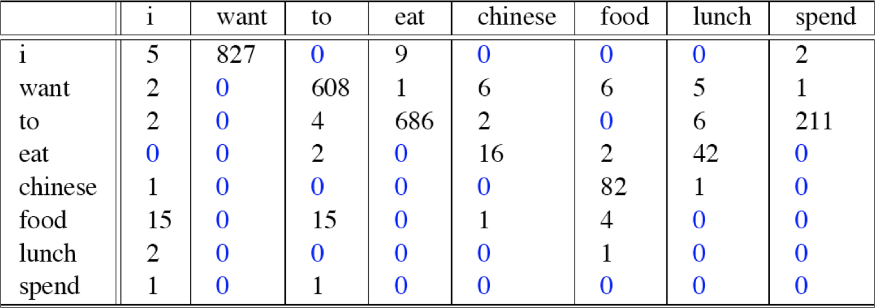
Bigram counts from 9222 Restaurant Sentences
NPTEL
N-gram Language Models
Week 2: Lecture 4

Slide 164
Computing bigram probabilities
Normlize by unigrams
NPTEL
N-gram Language Models
Week 2: Lecture 4
17 / 24

Slide 165
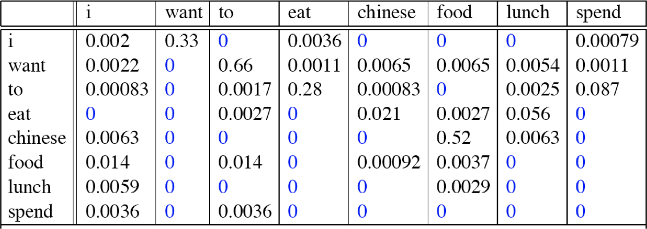
Computing bigram probabilities
Normlize by unigrams
Bigram Probabilities
NPTEL
N-gram Language Models
Week 2: Lecture 4
17 / 24

Slide 166
Computing Sentence Probabilities
P(<s> I want english food </s>)
= P(I | <s>) x P(want | I) x P(english | want) x P(food | english ) x P(</s> | food)
NPTEL
N-gram Language Models
Week 2: Lecture 4
18 / 24

Slide 167
Computing Sentence Probabilities
P(<s> I want english food </s>)
= P(I | <s>) x P(want | I) x P(english | want) x P(food | english ) x P(</s> | food)
= 0.000031
NPTEL
N-gram Language Models
Week 2: Lecture 4
18 / 24

Slide 168
What knowledge does n-gram represent?
P(english|want) = .0011
P(chinese|want) = .0065
P(to|want) = .66 P(eat | to) = .28 P(food | to) = 0 P(want | spend) = 0 P (i | <s>) = .25
NPTEL
N-gram Language Models
Week 2: Lecture 4

Slide 169
Practical Issues
Everything in log space
Avoids underflow
NPTEL
N-gram Language Models
Week 2: Lecture 4
20 / 24

Slide 170
Practical Issues
Everything in log space
Avoids underflow
Adding is faster than multiplying
NPTEL
N-gram Language Models
Week 2: Lecture 4
20 / 24

Slide 171
Practical Issues
Everything in log space
Avoids underflow
Adding is faster than multiplying
log(p₁ × p₂ × p₃ × p₄) = logp₁ + logp₂ + logp₃ + logp₄
Handling zeros
Use smoothing
NPTEL
N-gram Language Models
Week 2: Lecture 4
20 / 24

Slide 172
Language Modeling Toolkit
SRILM
http://www.speech.sri.com/projects/srilm/
NPTEL
N-gram Language Models
Week 2: Lecture 4

Slide 173
Google N-grams
Number of tokens: 1,024,908,267,229 Number of sentences: 95,119,665,584 Number of unigrams: 13,588,391 Number of bigrams: 314,843,401 Number of trigrams: 977,069,902 Number of fourgrams: 1,313,818,354 Number of fivegrams: 1,176,470,663
http://googleresearch.blogspot.in/2006/08/ all-our-n-gram-are-belong-to-you.html
NPTEL
N-gram Language Models
Week 2: Lecture 4

Slide 174
Example from the 4-gram data
serve as the inspector 66 serve as the inspiration 1390 serve as the installation 136 serve as the institute 187 serve as the institution 279 serve as the institutional 461
NPTEL
N-gram Language Models
Week 2: Lecture 4

Slide 175
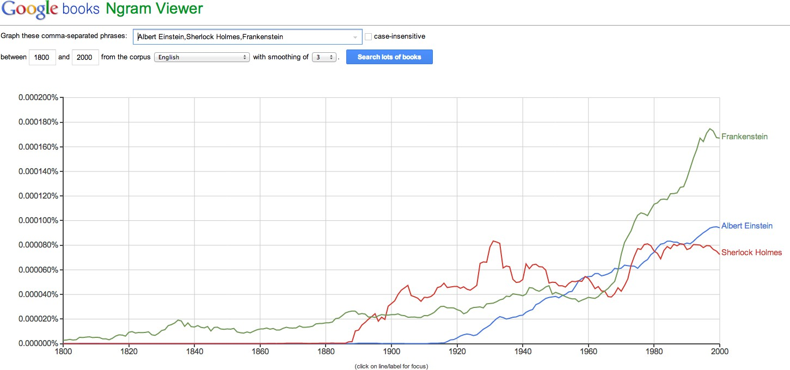
Google books Ngram Data
NPTEL
N-gram Language Models
Week 2: Lecture 4

Slide 176
Evaluation of Language Models, Basic Smoothing
NPTEL
Pawan Goyal
CSE, IITKGP
Week 2: Lecture 5
Evaluation of Language Models, Basic Smoothing
Week 2: Lecture 5

Slide 177
Evaluating Language Model
Does it prefer good sentences to bad sentences?
Assign higher probability to real (or frequently observed) sentences than ungrammatical (or rarely observed) ones
NPTEL
Evaluation of Language Models, Basic Smoothing
Week 2: Lecture 5
2 / 16

Slide 178
Evaluating Language Model
Does it prefer good sentences to bad sentences?
Assign higher probability to real (or frequently observed) sentences than ungrammatical (or rarely observed) ones
Training and Test Corpora
Parameters of the model are trained on a large corpus of text, called
training set.
Performance is tested on a disjoint (held-out) test data using an
evaluation metric
NPTEL
Evaluation of Language Models, Basic Smoothing
Week 2: Lecture 5
2 / 16

Slide 179
Extrinsic evaluation of N-grams models
Comparison of two models, A and B
Use each model for one or more tasks: spelling corrector, speech recognizer, machine translation
Get accuracy values for A and B Compare accuracy for A and B
NPTEL
Evaluation of Language Models, Basic Smoothing
Week 2: Lecture 5

Slide 180
Intrinsic evaluation: Perplexity
Intuition: The Shannon Game
How well can we predict the next word?
NPTEL
Evaluation of Language Models, Basic Smoothing
Week 2: Lecture 5
4 / 16

Slide 181
Intrinsic evaluation: Perplexity
Intuition: The Shannon Game
How well can we predict the next word?
I always order pizza with cheese and . . . The president of India is . . .
I wrote a . . .
NPTEL
Evaluation of Language Models, Basic Smoothing
Week 2: Lecture 5
4 / 16

Slide 182
Intrinsic evaluation: Perplexity
Intuition: The Shannon Game
How well can we predict the next word?
I always order pizza with cheese and . . . The president of India is . . .
I wrote a . . .
Unigram model doesn’t work for this game.
NPTEL
Evaluation of Language Models, Basic Smoothing
Week 2: Lecture 5
4 / 16

Slide 183
Intrinsic evaluation: Perplexity
Intuition: The Shannon Game
How well can we predict the next word?
I always order pizza with cheese and . . . The president of India is . . .
I wrote a . . .
Unigram model doesn’t work for this game.
A better model of text
is one which assigns a higher probability to the actual word
NPTEL
Evaluation of Language Models, Basic Smoothing
Week 2: Lecture 5
4 / 16

Slide 184
Perplexity
The best language model is one that best predics an unseen test set
Perplexity (PP(W))
Perplexity is the inverse probability of the test data, normalized by the number of words:
NPTEL
Evaluation of Language Models, Basic Smoothing
Week 2: Lecture 5
5 / 16

Slide 185
Perplexity
The best language model is one that best predics an unseen test set
Perplexity (PP(W))
Perplexity is the inverse probability of the test data, normalized by the number of words:
PP(W) = P(w w . . . w )
—
1
N
1 2 N
NPTEL
Evaluation of Language Models, Basic Smoothing
Week 2: Lecture 5
5 / 16

Slide 186
Perplexity
The best language model is one that best predics an unseen test set
Perplexity (PP(W))
Perplexity is the inverse probability of the test data, normalized by the number of words:
PP(W) = P(w w . . . w )
—
1
N
1 2 N
NPTEL
Applying chain Rule
1
N
∏
1
PP(W) =
P(w |w . . . w )
i 1 i−1
Evaluation of Language Models, Basic Smoothing
Week 2: Lecture 5
5 / 16

Slide 187
Perplexity
The best language model is one that best predics an unseen test set
Perplexity (PP(W))
Perplexity is the inverse probability of the test data, normalized by the number of words:
PP(W) = P(w w . . . w )
—
1
N
1 2 N
NPTEL
Applying chain Rule
1
N
∏
1
PP(W) =
P(w |w . . . w )
i 1 i−1
For bigrams
1
N
1
PP(W) =
∏ P(w_{i}|w_{i−1})
Evaluation of Language Models, Basic Smoothing
Week 2: Lecture 5
5 / 16

Slide 188
Example: A Simple Scenario
Consider a sentence consisting of N random digits
NPTEL
Evaluation of Language Models, Basic Smoothing
Week 2: Lecture 5
6 / 16

Slide 189
Example: A Simple Scenario
Consider a sentence consisting of N random digits
Find the perplexity of this sentence as per a model that assigns a probability p = 1/10 to each digit.
NPTEL
Evaluation of Language Models, Basic Smoothing
Week 2: Lecture 5
6 / 16

Slide 190
Example: A Simple Scenario
Consider a sentence consisting of N random digits
Find the perplexity of this sentence as per a model that assigns a probability p = 1/10 to each digit.
NPTEL
PP(W) = P(w w . . . w )
—
1
N
1 2 N
Evaluation of Language Models, Basic Smoothing
Week 2: Lecture 5
6 / 16

Slide 191
Example: A Simple Scenario
Consider a sentence consisting of N random digits
Find the perplexity of this sentence as per a model that assigns a probability p = 1/10 to each digit.
NPTEL
PP(W) = P(w w . . . w )
—
1
N
1 2 N
! 1
N
N
—
1
=
10
Evaluation of Language Models, Basic Smoothing
Week 2: Lecture 5
6 / 16

Slide 192
Example: A Simple Scenario
Consider a sentence consisting of N random digits
Find the perplexity of this sentence as per a model that assigns a probability p = 1/10 to each digit.
NPTEL
PP(W) = P(w w . . . w )
—
1
N
1 2 N
! 1
N
N
—
1
=
10
1
−1
=
10
= 10
Evaluation of Language Models, Basic Smoothing
Week 2: Lecture 5
6 / 16

Slide 193
Lower perplexity = better model
WSJ Corpus
Training: 38 million words
Test: 1.5 million words
NPTEL
Evaluation of Language Models, Basic Smoothing
Week 2: Lecture 5
7 / 16

Slide 194
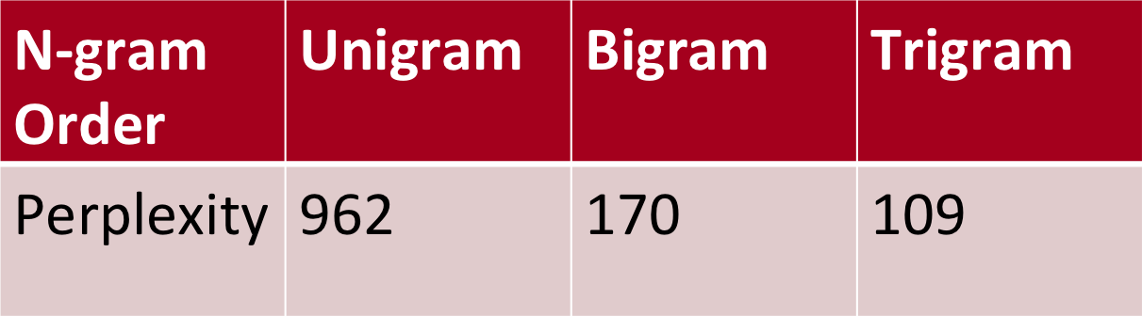
Lower perplexity = better model
WSJ Corpus
Training: 38 million words
Test: 1.5 million words
NPTEL
Evaluation of Language Models, Basic Smoothing
Week 2: Lecture 5
7 / 16

Slide 195
Lower perplexity = better model
WSJ Corpus
Training: 38 million words
Test: 1.5 million words
NPTEL
Unigram perplexity: 962?
The model is as confused on test data as if it had to choose uniformly and independently among 962 possibilities for each word.
Evaluation of Language Models, Basic Smoothing
Week 2: Lecture 5
7 / 16

Slide 196
The Shannon Visualization Method
Use the language model to generate word sequences
NPTEL
Evaluation of Language Models, Basic Smoothing
Week 2: Lecture 5
8 / 16

Slide 197
The Shannon Visualization Method
Use the language model to generate word sequences
Choose a random bigram (<s>,w) as per its probability
NPTEL
Evaluation of Language Models, Basic Smoothing
Week 2: Lecture 5
8 / 16

Slide 198
The Shannon Visualization Method
Use the language model to generate word sequences
Choose a random bigram (<s>,w) as per its probability
Choose a random bigram (w,x) as per its probability
NPTEL
Evaluation of Language Models, Basic Smoothing
Week 2: Lecture 5
8 / 16

Slide 199
The Shannon Visualization Method
Use the language model to generate word sequences
Choose a random bigram (<s>,w) as per its probability
Choose a random bigram (w,x) as per its probability
And so on until we choose
</s>
NPTEL
Evaluation of Language Models, Basic Smoothing
Week 2: Lecture 5
8 / 16

Slide 200
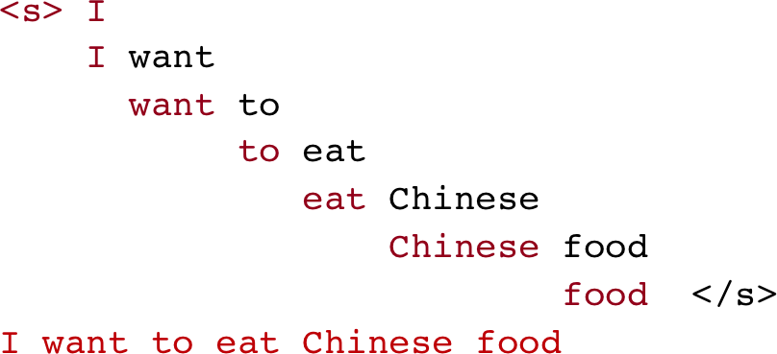
The Shannon Visualization Method
Use the language model to generate word sequences
Choose a random bigram (<s>,w) as per its probability
Choose a random bigram (w,x) as per its probability
And so on until we choose
</s>
NPTEL
Evaluation of Language Models, Basic Smoothing
Week 2: Lecture 5
8 / 16

Slide 201
Shakespeare as Corpus
N = 884,647 tokens, V = 29,066
Shakespeare produced 300,000 bigram types out of V² = 844 million possible bigrams.
NPTEL
Evaluation of Language Models, Basic Smoothing
Week 2: Lecture 5

Slide 202
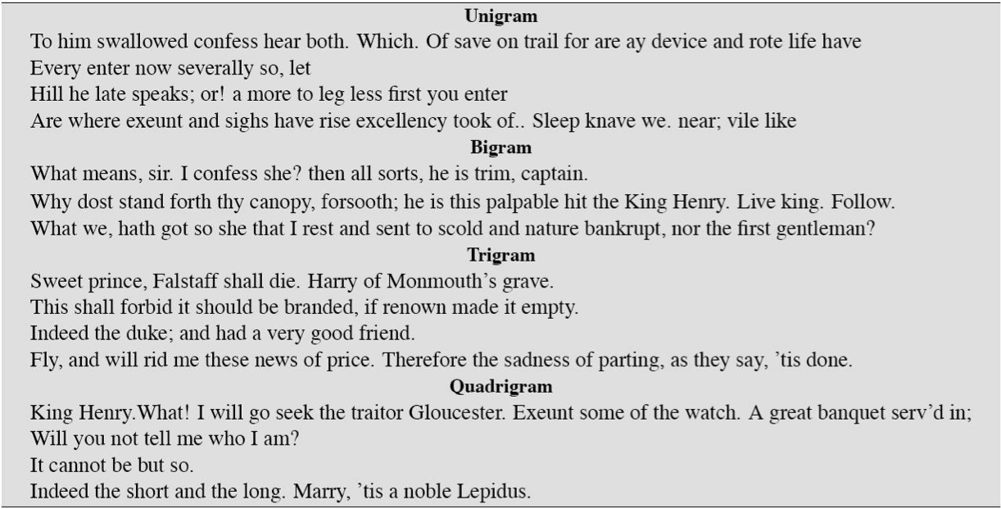
Approximating Shakespeare
NPTEL
Evaluation of Language Models, Basic Smoothing
Week 2: Lecture 5

Slide 203
Problems with simple MLE estimate: zeros
NPTEL
Evaluation of Language Models, Basic Smoothing
Week 2: Lecture 5
11 / 16

Slide 204
Problems with simple MLE estimate: zeros
Training set
... denied the allegations
... denied the reports
... denied the claims
... denied the request
NPTEL
Evaluation of Language Models, Basic Smoothing
Week 2: Lecture 5
11 / 16

Slide 205
Problems with simple MLE estimate: zeros
Training set
... denied the allegations
... denied the reports
... denied the claims
... denied the request
Test Data
... denied the offer
... denied the loan
NPTEL
Evaluation of Language Models, Basic Smoothing
Week 2: Lecture 5
11 / 16

Slide 206
Problems with simple MLE estimate: zeros
Training set
... denied the allegations
... denied the reports
... denied the claims
... denied the request
Test Data
... denied the offer
... denied the loan
NPTEL
Zero probability n-grams
P(offer | denied the) = 0
Evaluation of Language Models, Basic Smoothing
Week 2: Lecture 5
11 / 16

Slide 207
Problems with simple MLE estimate: zeros
Training set
... denied the allegations
... denied the reports
... denied the claims
... denied the request
Test Data
... denied the offer
... denied the loan
NPTEL
Zero probability n-grams
P(offer | denied the) = 0
The test set will be assigned a probability 0
Evaluation of Language Models, Basic Smoothing
Week 2: Lecture 5
11 / 16

Slide 208
Problems with simple MLE estimate: zeros
Training set
... denied the allegations
... denied the reports
... denied the claims
... denied the request
Test Data
... denied the offer
... denied the loan
NPTEL
Zero probability n-grams
P(offer | denied the) = 0
The test set will be assigned a probability 0 And the perplexity can’t be computed
Evaluation of Language Models, Basic Smoothing
Week 2: Lecture 5
11 / 16

Slide 209
Language Modeling: Smoothing
NPTEL
Evaluation of Language Models, Basic Smoothing
Week 2: Lecture 5
12 / 16

Slide 210
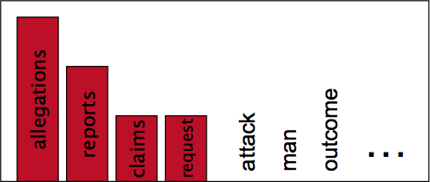
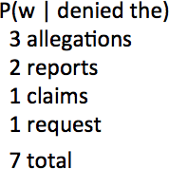
Language Modeling: Smoothing
With sparse statistics
NPTEL
Evaluation of Language Models, Basic Smoothing
Week 2: Lecture 5
12 / 16

Slide 211
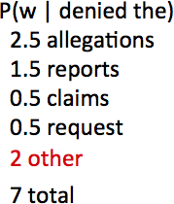
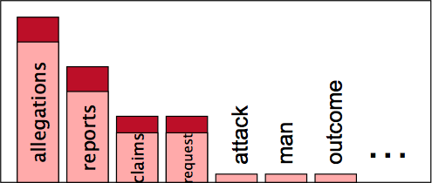
Language Modeling: Smoothing
With sparse statistics
NPTEL
Steal probability mass to generalize better
Evaluation of Language Models, Basic Smoothing
Week 2: Lecture 5
12 / 16

Slide 212
Laplace Smoothing (Add-one estimation)
Pretend as if we saw each word (N-gram) one more time that we actually did
NPTEL
Evaluation of Language Models, Basic Smoothing
Week 2: Lecture 5
13 / 16

Slide 213
Laplace Smoothing (Add-one estimation)
Pretend as if we saw each word (N-gram) one more time that we actually did
Just add one to all the counts!
NPTEL
Evaluation of Language Models, Basic Smoothing
Week 2: Lecture 5
13 / 16

Slide 214
Laplace Smoothing (Add-one estimation)
Pretend as if we saw each word (N-gram) one more time that we actually did
Just add one to all the counts!
NPTEL
MLE estimate for bigram: P_{MLE}(w_{i}|w_{i−1}) = ^{c(wi−1,wi)}
c(w_{i−1})
Evaluation of Language Models, Basic Smoothing
Week 2: Lecture 5
13 / 16

Slide 215
Laplace Smoothing (Add-one estimation)
Pretend as if we saw each word (N-gram) one more time that we actually did
Just add one to all the counts!
NPTEL
MLE estimate for bigram: P_{MLE}(w_{i}|w_{i−1}) = ^{c(wi−1,wi)}
c(w_{i−1})
Add-1 estimate: P_{Add−1}(w_{i}|w_{i−1}) = ^{c(wi−1,wi)+1}
c(w_{i−1})+V
Evaluation of Language Models, Basic Smoothing
Week 2: Lecture 5
13 / 16

Slide 216
Reconstituted counts as effect of smoothing
Effective bigram count (c∗(w_{n−1}w_{n}))
NPTEL
c∗(w_{n−1}w_{n})
c(w_{n−1}w_{n}) + 1
=
c(w_{n} )
c(w_{n−1}) + V
−1
Evaluation of Language Models, Basic Smoothing
Week 2: Lecture 5

Slide 217

Comparing with bigrams: Restaurant corpus
NPTEL
Evaluation of Language Models, Basic Smoothing
Week 2: Lecture 5
15 / 16

Slide 218
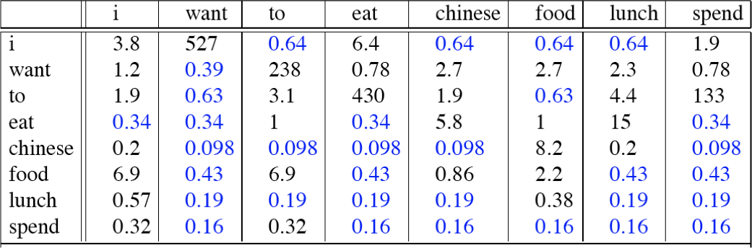
Comparing with bigrams: Restaurant corpus
NPTEL
Evaluation of Language Models, Basic Smoothing
Week 2: Lecture 5
15 / 16

Slide 219
More general formulations: Add-k
c(w_{i−1}, w_{i}) + k
) =
(w |w
PAdd−k i i−1
c(w_{i−1}) + kV
NPTEL
Evaluation of Language Models, Basic Smoothing
Week 2: Lecture 5
16 / 16

Slide 220
More general formulations: Add-k
c(w_{i−1}, w_{i}) + k
) =
(w |w
PAdd−k i i−1
c(w_{i−1}) + kV
c(w_{i−1}, w_{i}) + m( ¹ )
PAdd−k(wi|wi−1) =
V
c(w_{i−1}) + m
NPTEL
Evaluation of Language Models, Basic Smoothing
Week 2: Lecture 5
16 / 16

Slide 221
More general formulations: Add-k
c(w_{i−1}, w_{i}) + k
) =
(w |w
PAdd−k i i−1
c(w_{i−1}) + kV
c(w_{i−1}, w_{i}) + m( ¹ )
PAdd−k(wi|wi−1) =
Unigram prior smoothing:
V
c(w_{i−1}) + m
NPTEL
c(w_{i−1}, w_{i}) + mP(w_{i})
PUnigramPrior(wi|wi−1) =
c(w_{i−1}) + m
Evaluation of Language Models, Basic Smoothing
Week 2: Lecture 5
16 / 16

Slide 222
More general formulations: Add-k
c(w_{i−1}, w_{i}) + k
) =
(w |w
PAdd−k i i−1
c(w_{i−1}) + kV
c(w_{i−1}, w_{i}) + m( ¹ )
PAdd−k(wi|wi−1) =
Unigram prior smoothing:
V
c(w_{i−1}) + m
NPTEL
c(w_{i−1}, w_{i}) + mP(w_{i})
PUnigramPrior(wi|wi−1) =
c(w_{i−1}) + m
A good value of k or m?
Can be optimized on held-out set
Evaluation of Language Models, Basic Smoothing
Week 2: Lecture 5
16 / 16

